Slide 1
Fraud Detection: Exploratory Data Analysis and Machine Learning
Qin Gui
07/2019

Slide 2
Content
EDA (exploratory data analysis)
Data clean
Machine learning
Visualization
Libraries used: pandas, numpy, matplotlib, seaborn, sklearn

Slide 3
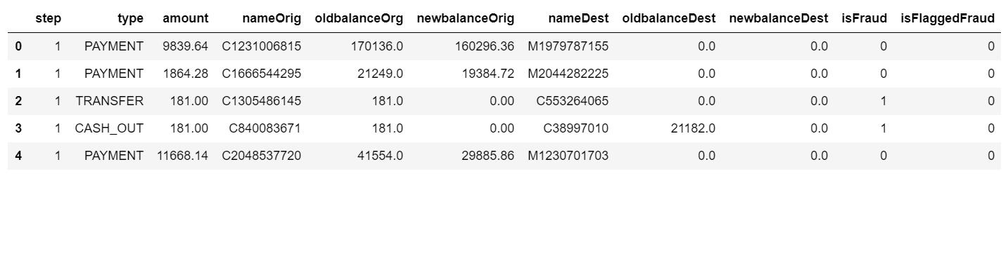
Synthetic finical data
Data length: 6,362,620
Columns: 11
step type amount nameOrig/nameDest isFlaggedFraud balance
Notes:
First is to explore the data. I found this is the most important step in the whole process. No good result can be obtained without fully understand the original data.
The data has over 6 millions transaction records, with 11 columns including: step (hour), transaction types, transaction amount, customer ID who started the transaction, initial balance before the transaction, balance after, recipient’s ID, recipient’s balance before transaction, recipient’s balance after, is the transaction fraud or not, is flagged fraud or not.
For the customer and recipient’s ID, no relation to fraud was found, then these two columns were deleted during machine learning step.
For the isFlaggedFraud column, the fraud transaction amount more then 200,000 should be labeled flag, but it doesn’t follow the rule, and since all the flagged fraud transactions also labeled fraud, then we just deleted this column during machine learning.

Slide 4
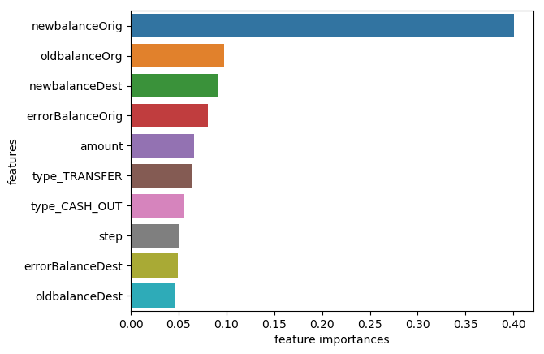
feature importance
Notes:
The importance of a feature is the increase in the prediction error of the model after we permuted the feature’s values, which breaks the relationship between the feature and the true outcome.
A feature is “important” if shuffling its values increases the model error, because in this case the model relied on the feature for the prediction. A feature is “unimportant” if shuffling its values leaves the model error unchanged, because in this case the model ignored the feature for the prediction.

Slide 5
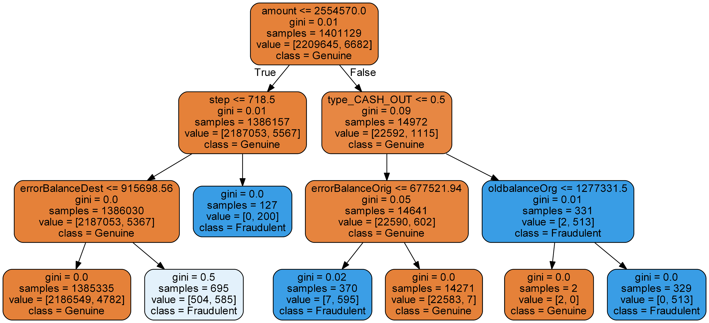
Machine learning Random forests classifier score: 0.99998
Notes:
In the tree plot, each node contains the condition (if/else rule) that splits the data, along with a series of other metrics of the node. Gini refers to the Gini impurity, a measure of the impurity of the node, i.e. how homogeneous are the samples within the node. We say that a node is pure when all its samples belong to the same class. In that case, there is no need for further split and this node is called a leaf. Samples is the number of instances in the node, while the value array shows the distribution of these instances per class.

Slide 6
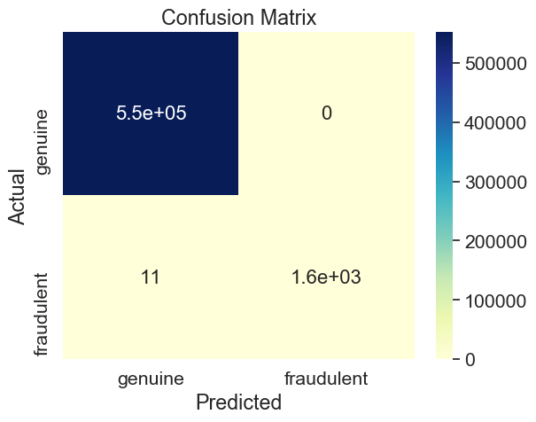
Model confusion matrix
Notes:
The confusion matrix showed that over half a millions genuine transactions were predicted to be genuine, around 1600 fraudulent transactions were predicted fraud; only 11 fraudulent transactions were predicted to be genuine; none of the genuine transaction were predicted to be fraud.

Slide 7
Thank you !

Slide 8
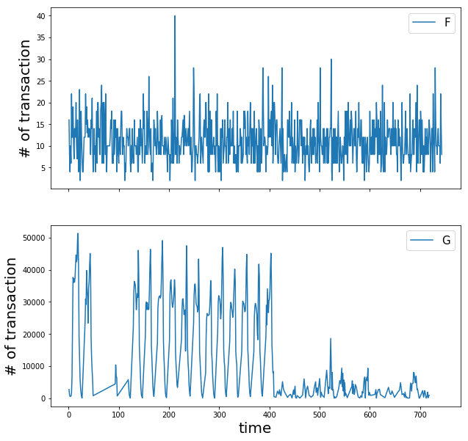
Transaction time and fraud
Notes:
Different from the genuine transaction, which appears to be inactive at some of the time points, fraudulent transactions is active all through the time.

Slide 9

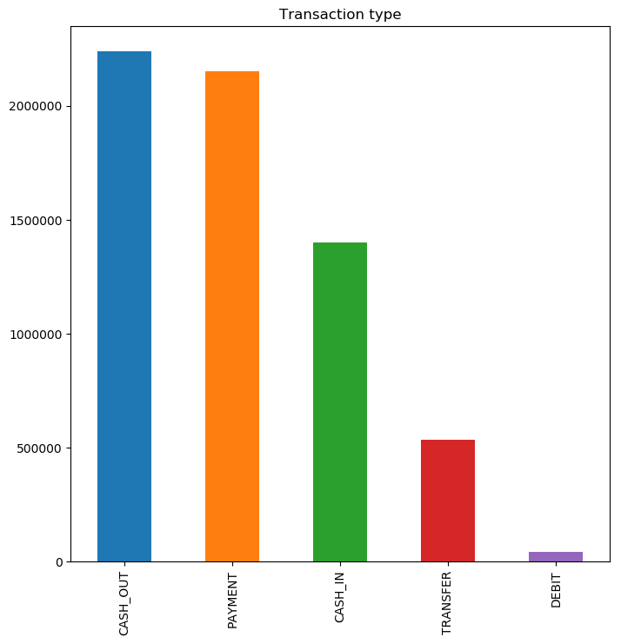
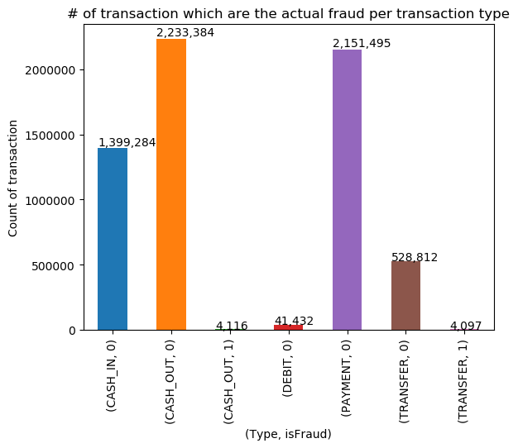
Transaction types and fraud
CASH_OUT
PAYMENT
CASH_IN
TRANSFER
DEBIT
Notes:
Five types of transactions. Fraudulent transactions only existed in types of CASH_OUT and TRANSFER. None in the other three types.

Slide 10
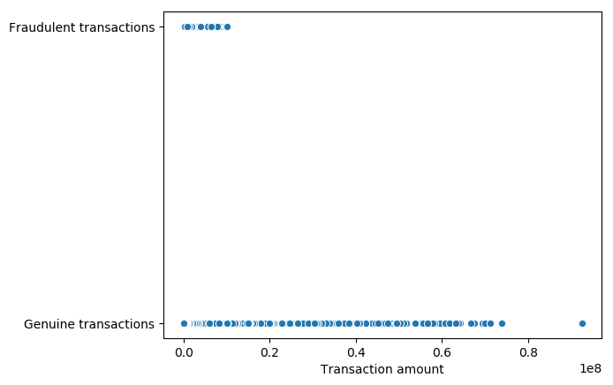
Transaction Amount and Fraud
Notes:
Genuine transactions have longer span in the amount than fraudulent transactions.

Slide 11
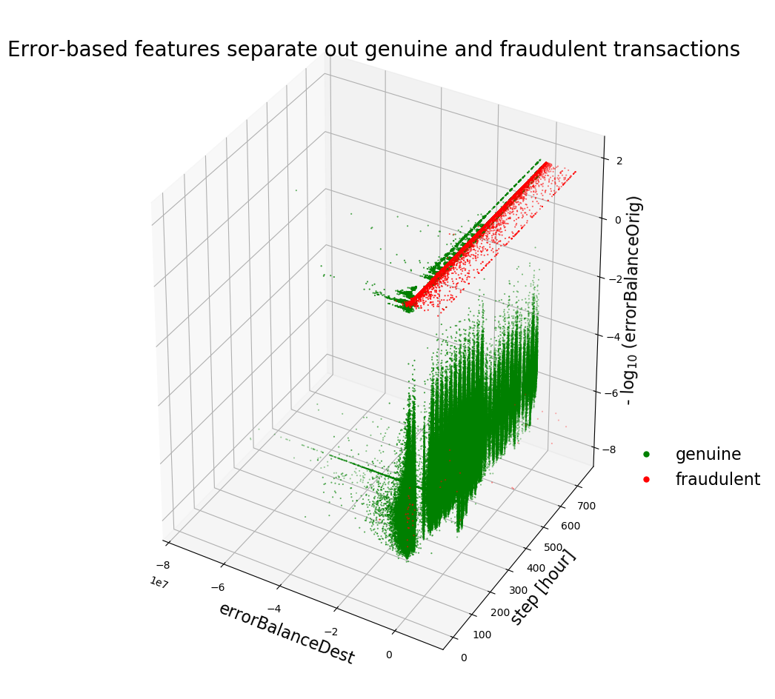
Balance and fraud
Notes:
Most fraud transactions don’t generate error in the original balance
X['errorBalanceOrig'] = X.newbalanceOrig + X.amount - X.oldbalanceOrg
X['errorBalanceDest'] = X.oldbalanceDest + X.amount - X.newbalanceDest

Slide 12
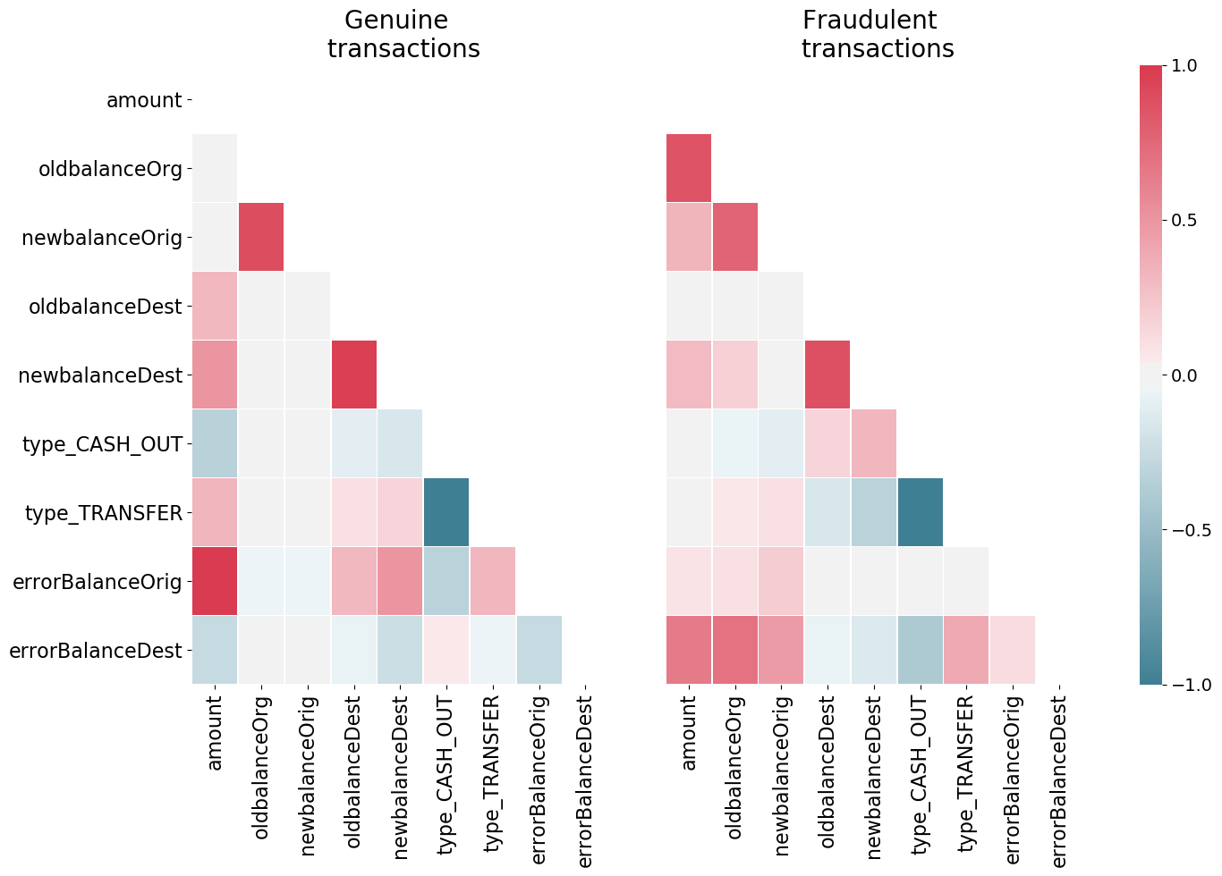
Features Correlation heat map

